Slide 1
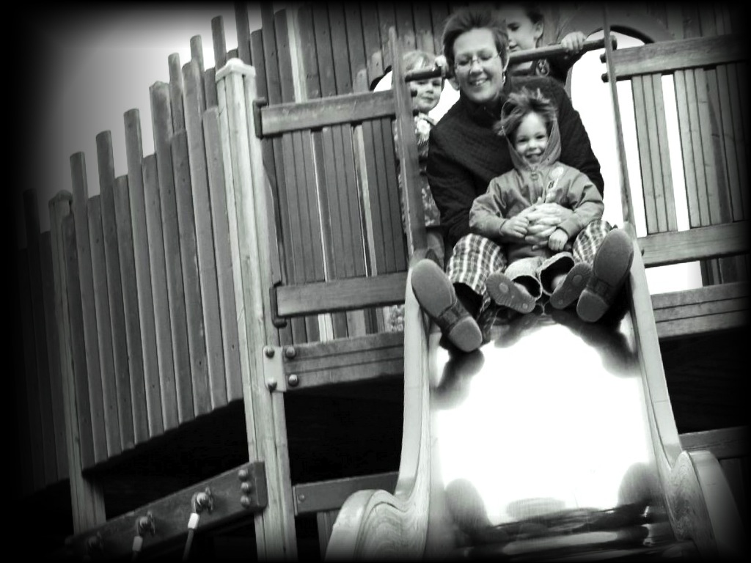
&
Minimal
Theory of Mind
Joint Action
s.butterfill@warwick.ac.uk

Slide 2
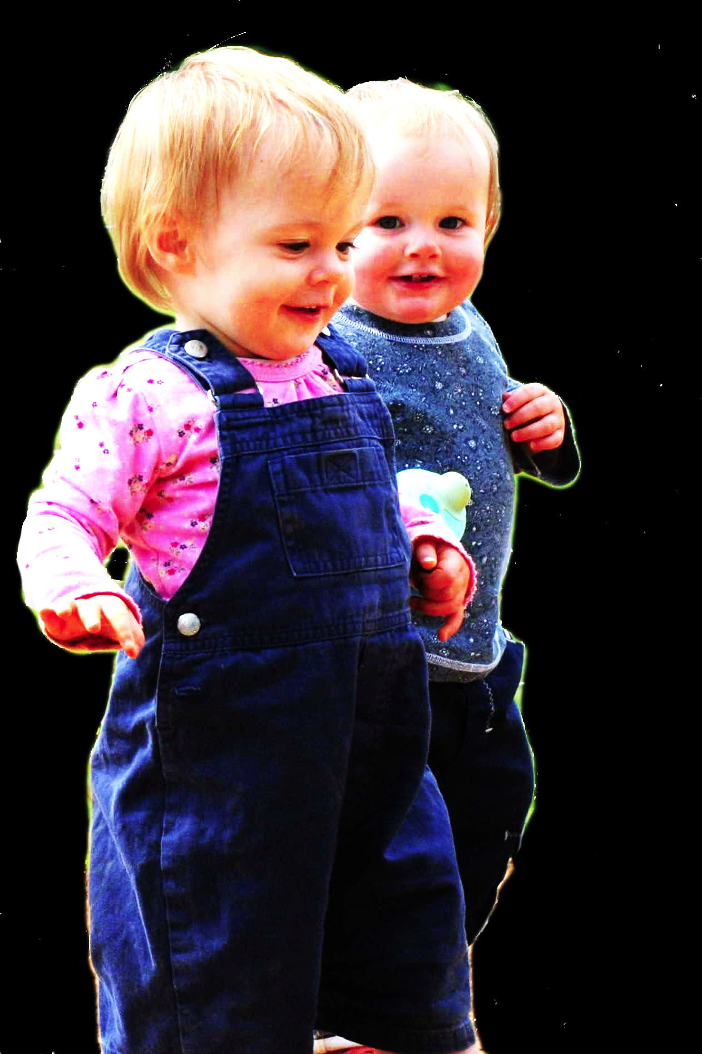
challenge
Explain the emergence, in evolution or development, of full-blown theory of mind cognition.

Slide 3
challenge
Explain the emergence, in evolution or development, of full-blown theory of mind cognition.
puzzle

Slide 4
Theory of mind abilities are widespread
18-month-olds point to inform, and predict actions based on false beliefs
(Liszkowski et al 2006)
(Onishi & Baillargeon 2005; Southgate et al 2007)

Slide 5
Theory of mind abilities are widespread
18-month-olds point to inform, and predict actions based on false beliefs
Scrub-jays selectively re-cache their food in ways that deprive competitors of knowledge of its location
(Liszkowski et al 2006)
(Onishi & Baillargeon 2005; Southgate et al 2007)
(Clayton, Dally & Emery 2007)

Slide 6
Theory of mind abilities are widespread
18-month-olds point to inform, and predict actions based on false beliefs
Scrub-jays selectively re-cache their food in ways that deprive competitors of knowledge of its location
Chimpanzees conceal their approach from a competitor’s view, and act in ways that are optimal given what another has seen
(Liszkowski et al 2006)
(Onishi & Baillargeon 2005; Southgate et al 2007)
(Clayton, Dally & Emery 2007)
(Hare, Call & Tomasello 2006)
(Hare, Call & Tomasello 2001)

Slide 7
Theory of mind abilities are widespread
18-month-olds point to inform, and predict actions based on false beliefs
Scrub-jays selectively re-cache their food in ways that deprive competitors of knowledge of its location
Chimpanzees conceal their approach from a competitor’s view, and act in ways that are optimal given what another has seen
(Liszkowski et al 2006)
(Onishi & Baillargeon 2005; Southgate et al 2007)
(Clayton, Dally & Emery 2007)
(Hare, Call & Tomasello 2006)
(Hare, Call & Tomasello 2001)

Slide 8
Theory of mind abilities are widespread
18-month-olds point to inform, and predict actions based on false beliefs
Scrub-jays selectively re-cache their food in ways that deprive competitors of knowledge of its location
Chimpanzees conceal their approach from a competitor’s view, and act in ways that are optimal given what another has seen
(Liszkowski et al 2006)
question
(Onishi & Baillargeon 2005; Southgate et al 2007)
What could infants, chimps and scrub-jays represent that would enable them, within limits, to track others’ perceptions, knowledge, beliefs and other propositional attitudes?
(Clayton, Dally & Emery 2007)
(Hare, Call & Tomasello 2006)
(Hare, Call & Tomasello 2001)

Slide 9
Theory of mind abilities are widespread
18-month-olds point to inform, and predict actions based on false beliefs
Scrub-jays selectively re-cache their food in ways that deprive competitors of knowledge of its location
Chimpanzees conceal their approach from a competitor’s view, and act in ways that are optimal given what another has seen
Representing perceptions, knowledge states and beliefs is hard

Slide 10
Theory of mind abilities are widespread
18-month-olds point to inform, and predict actions based on false beliefs
Scrub-jays selectively re-cache their food in ways that deprive competitors of knowledge of its location
Chimpanzees conceal their approach from a competitor’s view, and act in ways that are optimal given what another has seen
Representing perceptions, knowledge states and beliefs is hard, for it requires
(a) conceptual sophistication
- takes years to develop
- development tied to acquisition of executive function and language
- development facilitated by training and siblings

Slide 11
Theory of mind abilities are widespread
18-month-olds point to inform, and predict actions based on false beliefs
Scrub-jays selectively re-cache their food in ways that deprive competitors of knowledge of its location
Chimpanzees conceal their approach from a competitor’s view, and act in ways that are optimal given what another has seen
Representing perceptions, knowledge states and beliefs is hard, for it requires
(a) conceptual sophistication
- takes years to develop
- development tied to acquisition of executive function and language
- development facilitated by training and siblings
(b) scarce cognitive resources
- attention
- working memory

Slide 12
Theory of mind abilities are widespread
18-month-olds point to inform, and predict actions based on false beliefs
Scrub-jays selectively re-cache their food in ways that deprive competitors of knowledge of its location
Chimpanzees conceal their approach from a competitor’s view, and act in ways that are optimal given what another has seen
Representing perceptions, knowledge states and beliefs is hard, for it requires
(a) conceptual sophistication
- takes years to develop
- development tied to acquisition of executive function and language
- development facilitated by training and siblings
(b) scarce cognitive resources
- attention
- working memory

Slide 13
challenge
Explain the emergence, in evolution or development, of full-blown theory of mind cognition.
puzzle
What could infants, chimps and scrub-jays represent that would enable them, within limits, to track others’ perceptions, knowledge, beliefs and other propositional attitudes?

Slide 14
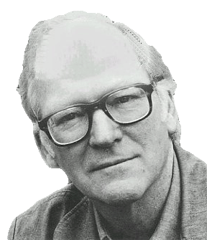
“We are stuck with our two main ways of describing and explaining things, one which treats objects and events as mindless, and the other which treats objects and events as having propositional attitudes. I see no way of bridging the gap”
(Davidson 2003: 697)

Slide 15
“We are stuck with our two main ways of describing and explaining things, one which treats objects and events as mindless, and the other which treats objects and events as having propositional attitudes. I see no way of bridging the gap”
(Davidson 2003: 697)

Slide 16
“We are stuck with our two main ways of describing and explaining things, one which treats objects and events as mindless, and the other which treats objects and events as having propositional attitudes. I see no way of bridging the gap”
(Davidson 2003: 697)

Slide 17

“We are stuck with our two main ways of describing and explaining things, one which treats objects and events as mindless, and the other which treats objects and events as having propositional attitudes. I see no way of bridging the gap”
(Davidson 2003: 697)

Slide 18

Your field = a set of objects related to you by proximity, orientation, lighting and other factors
You encounter an object = it is in your field
You register an object at a location = you most recently encountered the object at that location

Slide 19
Your field = a set of objects related to you by proximity, orientation, lighting and other factors
You encounter an object = it is in your field
You register an object at a location = you most recently encountered the object at that location
proximity
orientation
lighting
barriers
trajectory

Slide 20
Your field = a set of objects related to you by proximity, orientation, lighting and other factors
You encounter an object = it is in your field
You register an object at a location = you most recently encountered the object at that location
proximity
orientation
lighting
barriers
trajectory

Slide 21
Detour
Goals are not intentions

Slide 22
What is the relation between an action and the goal (or goals) to which it is directed?
out
out
act
out
out

Slide 23
What is the relation between an action and the goal (or goals) to which it is directed?
out
out
act
out
out

Slide 24
What is the relation between an action and the goal (or goals) to which it is directed?
out
out
act
out
intention or other goal-state
out

Slide 25
What is the relation between an action and the goal (or goals) to which it is directed?
teleological function
out
out
act
out
intention or other goal-state
out

Slide 26
(i) in the past, actions of this type have caused outcomes of this type; (ii) this action happens now in part because (i).
What is the relation between an action and the goal (or goals) to which it is directed?
teleological function
out
out
act
out
intention or other goal-state
out

Slide 27
(i) in the past, actions of this type have caused outcomes of this type; (ii) this action happens now in part because (i).
What is the relation between an action and the goal (or goals) to which it is directed?
teleological function
out
out
act
out
intention or other goal-state
It is possible to represent goal-directed actions without representing intentions.
out

Slide 28
End Detour

Slide 29
Your field = a set of objects related to you by proximity, orientation, lighting and other factors
You encounter an object = it is in your field
You register an object at a location = you most recently encountered the object at that location
Principle 3: one can’t goal-directedly act on an object unless one has encountered it.
Principle 2: correct registration is a condition of successful action.
Principle 3: when an agent performs a goal-directed action and the goal specifies an object, the agent will act as if the object were actually in the location she registers it at.
proximity
orientation
lighting
barriers
trajectory

Slide 30
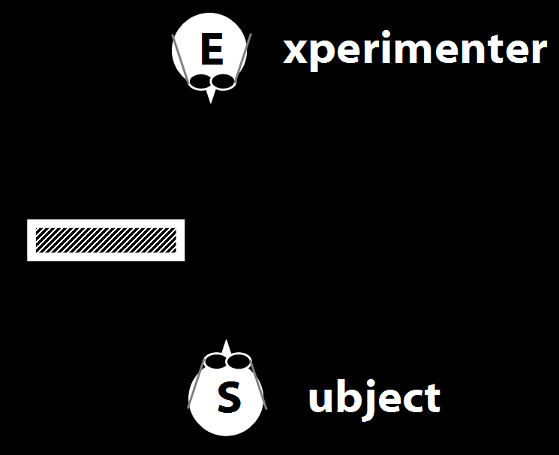
Your field = a set of objects related to you by proximity, orientation, lighting and other factors
You encounter an object = it is in your field
You register an object at a location = you most recently encountered the object at that location
Principle 3: one can’t goal-directedly act on an object unless one has encountered it.
Principle 2: correct registration is a condition of successful action.
Principle 3: when an agent performs a goal-directed action and the goal specifies an object, the agent will act as if the object were actually in the location she registers it at.
proximity
orientation
lighting
barriers
trajectory

Slide 31
Your field = a set of objects related to you by proximity, orientation, lighting and other factors
You encounter an object = it is in your field
You register an object at a location = you most recently encountered the object at that location
Principle 3: one can’t goal-directedly act on an object unless one has encountered it.
Principle 2: correct registration is a condition of successful action.
Principle 3: when an agent performs a goal-directed action and the goal specifies an object, the agent will act as if the object were actually in the location she registers it at.
“children could … think about what the other person saw rather than what they saw”
(Flavell, Shipstead & Croft 1978: 1210)
proximity
orientation
lighting
barriers
trajectory

Slide 32
Your field = a set of objects related to you by proximity, orientation, lighting and other factors
You encounter an object = it is in your field
You register an object at a location = you most recently encountered the object at that location
Principle 3: one can’t goal-directedly act on an object unless one has encountered it.
Principle 2: correct registration is a condition of successful action.
Principle 3: when an agent performs a goal-directed action and the goal specifies an object, the agent will act as if the object were actually in the location she registers it at.
“children could … think about what the other person saw rather than what they saw”
(Flavell, Shipstead & Croft 1978: 1210)
“children could … think about what the other person saw rather than what they saw”
(Flavell, Shipstead & Croft 1978: 1210)
proximity
orientation
lighting
barriers
trajectory

Slide 33
Your field = a set of objects related to you by proximity, orientation, lighting and other factors
You encounter an object = it is in your field
You register an object at a location = you most recently encountered the object at that location
Principle 3: one can’t goal-directedly act on an object unless one has encountered it.
Principle 2: correct registration is a condition of successful action.
Principle 3: when an agent performs a goal-directed action and the goal specifies an object, the agent will act as if the object were actually in the location she registers it at.
proximity
orientation
lighting
barriers
trajectory

Slide 34
Your field = a set of objects related to you by proximity, orientation, lighting and other factors
You encounter an object = it is in your field
You register an object at a location <= you most recently encountered the object at that location
Principle 3: one can’t goal-directedly act on an object unless one has encountered it.
Principle 2: correct registration is a condition of successful action.
Principle 3: when an agent performs a goal-directed action and the goal specifies an object, the agent will act as if the object were actually in the location she registers it at.
proximity
orientation
lighting
barriers
trajectory

Slide 35
Your field = a set of objects related to you by proximity, orientation, lighting and other factors
You encounter an object = it is in your field
You register an object at a location <= you most recently encountered the object at that location
Principle 3: one can’t goal-directedly act on an object unless one has encountered it.
Principle 4: correct registration is a condition of successful action.
Principle 3: when an agent performs a goal-directed action and the goal specifies an object, the agent will act as if the object were actually in the location she registers it at.
proximity
orientation
lighting
barriers
trajectory

Slide 36
source: Liszkowski et al (2008)

Slide 37
source: Liszkowski et al (2008)

Slide 38
source: Liszkowski et al (2008)

Slide 39
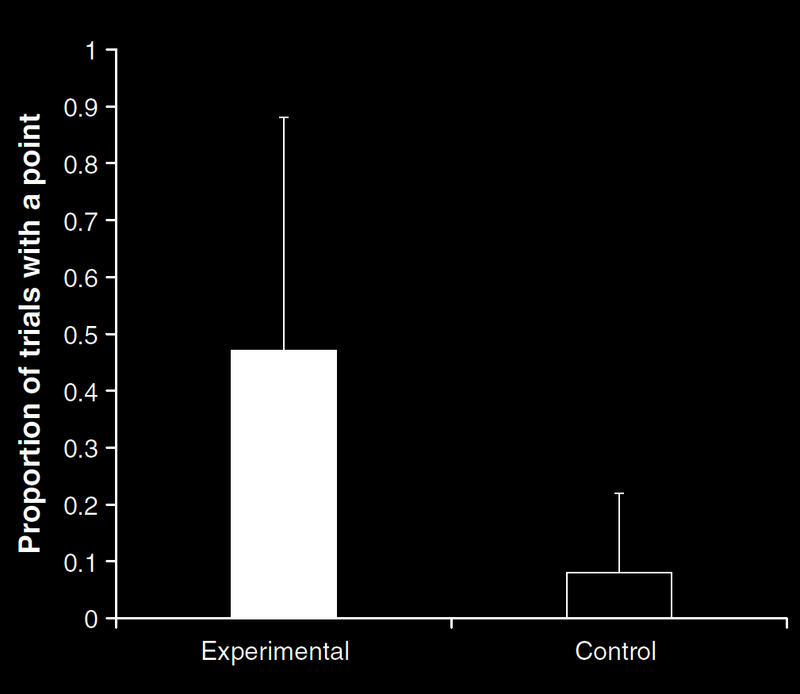
Your field = a set of objects related to you by proximity, orientation, lighting and other factors
You encounter an object = it is in your field
You register an object at a location <= you most recently encountered the object at that location
Principle 3: one can’t goal-directedly act on an object unless one has encountered it.
Principle 4: correct registration is a condition of successful action.
Principle 3: when an agent performs a goal-directed action and the goal specifies an object, the agent will act as if the object were actually in the location she registers it at.
source: Liszkowski et al (2008)
proximity
orientation
lighting
barriers
trajectory

Slide 40
source: Liszkowski et al (2008)

Slide 41
Your field = a set of objects related to you by proximity, orientation, lighting and other factors
You encounter an object = it is in your field
You register an object at a location <= you most recently encountered the object at that location
Principle 3: one can’t goal-directedly act on an object unless one has encountered it.
Principle 4: correct registration is a condition of successful action.
Principle 3: when an agent performs a goal-directed action and the goal specifies an object, the agent will act as if the object were actually in the location she registers it at.
source: Liszkowski et al (2008)
proximity
orientation
lighting
barriers
trajectory

Slide 42
Your field = a set of objects related to you by proximity, orientation, lighting and other factors
You encounter an object = it is in your field
You register an object at a location = you most recently encountered the object at that location
Principle 3: one can’t goal-directedly act on an object unless one has encountered it.
Principle 4: correct registration is a condition of successful action.
Principle 3: when an agent performs a goal-directed action and the goal specifies an object, the agent will act as if the object were actually in the location she registers it at.
“Helping by informing inextricably involves … an understanding of others’ goals and … of others’ ignorance.”
(Liszkowski, Carpenter & Tomasello 2008: 738-9)
source: Liszkowski et al (2008)
proximity
orientation
lighting
barriers
trajectory

Slide 43
Your field = a set of objects related to you by proximity, orientation, lighting and other factors
You encounter an object = it is in your field
You register an object at a location = you most recently encountered the object at that location
Principle 3: one can’t goal-directedly act on an object unless one has encountered it.
Principle 4: correct registration is a condition of successful action.
Principle 3: when an agent performs a goal-directed action and the goal specifies an object, the agent will act as if the object were actually in the location she registers it at.
“Helping by informing inextricably involves … an understanding of others’ goals and … of others’ ignorance.”
(Liszkowski, Carpenter & Tomasello 2008: 738-9)
“Helping by informing inextricably involves … an understanding of others’ goals and … of others’ ignorance.”
(Liszkowski, Carpenter & Tomasello 2008: 738-9)
source: Liszkowski et al (2008)
proximity
orientation
lighting
barriers
trajectory

Slide 44
Your field = a set of objects related to you by proximity, orientation, lighting and other factors
You encounter an object = it is in your field
You register an object at a location <= you most recently encountered the object at that location
Principle 3: one can’t goal-directedly act on an object unless one has encountered it.
Principle 4: correct registration is a condition of successful action.
Principle 3: when an agent performs a goal-directed action and the goal specifies an object, the agent will act as if the object were actually in the location she registers it at.
proximity
orientation
lighting
barriers
trajectory

Slide 45
Your field = a set of objects related to you by proximity, orientation, lighting and other factors
You encounter an object = it is in your field
You register an object at a location <= you most recently encountered the object at that location
Principle 3: one can’t goal-directedly act on an object unless one has encountered it.
Principle 4: correct registration is a condition of successful action.
Principle 5
proximity
orientation
lighting
barriers
trajectory

Slide 46
Your field = a set of objects related to you by proximity, orientation, lighting and other factors
You encounter an object = it is in your field
You register an object at a location <= you most recently encountered the object at that location
Principle 3: one can’t goal-directedly act on an object unless one has encountered it.
Principle 4: correct registration is a condition of successful action.
Principle 5: when an agent performs a goal-directed action and the goal specifies an object, the agent will act as if the object were actually in the location she registers it at.
proximity
orientation
lighting
barriers
trajectory

Slide 47
challenge
Explain the emergence, in evolution or development, of full-blown theory of mind cognition.
puzzle
What could infants, chimps and scrub-jays represent that would enable them, within limits, to track others’ perceptions, knowledge, beliefs and other propositional attitudes?

Slide 48
signature limits

Slide 49
1. Charly is Samantha
2. Mitch believes that Charly is in Baltimore
3. Mitch believes that Samantha is in Baltimore
(1) & (2) ⇒ (3)

Slide 50
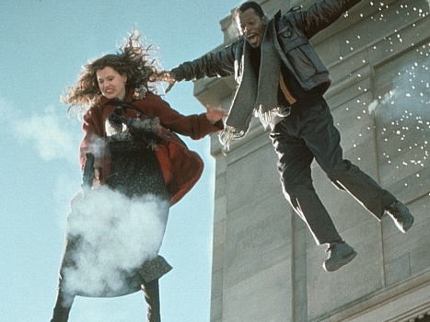
1. Charly is Samantha
2. Mitch believes that Charly is in Baltimore
3. Mitch believes that Samantha is in Baltimore
(1) & (2) ⇒ (3)

Slide 51
1. Charly is Samantha
2. Mitch believes that Charly is in Baltimore
3. Mitch believes that Samantha is in Baltimore
(1) & (2) ⇒ (3)
4. Mitch registers <Charly, Baltimore>
5. Mitch registers <Samantha, Baltimore>
(1) & (4) ⇒ (5)

Slide 52
False belief about location
False belief about identity
Subjects represent registration only
Subjects represent beliefs
pass
fail
pass
pass
Notes:
Need to say that there can also be mistakes about identity involving compression rather than expansion (the cars)

Slide 53
Rubio, Richardson & Butterfill
Notes:
First introduce them to a sequence in three slides ... [large pictures so hopefully everyone can see what’s going on]
These are all from the subject’s point of view.
We’re going to start with what looks almost exactly like the test condition from a standard false belief task.
(1) The observer watches as his car disappears behind a barrier on your [audience’s] left

Slide 54
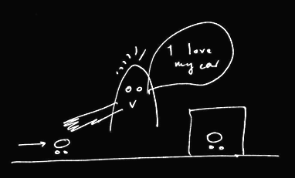
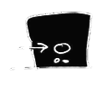
Rubio, Richardson & Butterfill
Notes:
First introduce them to a sequence in three slides ... [large pictures so hopefully everyone can see what’s going on]
These are all from the subject’s point of view.
We’re going to start with what looks almost exactly like the test condition from a standard false belief task.
(1) The observer watches as his car disappears behind a barrier on your [audience’s] left

Slide 55
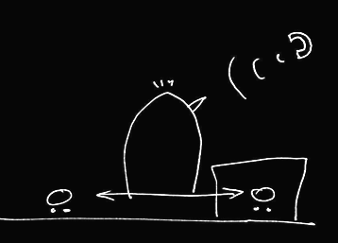

Rubio, Richardson & Butterfill
Notes:
(2) a telephone rings and the observer is distracted ... meanwhile the cars silently swap places (they’re electric cars, natch).

Slide 56
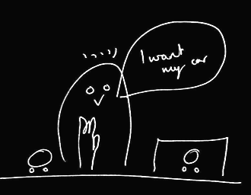
Rubio, Richardson & Butterfill
Notes:
(3) the observer comes back and wants to get her car (note the raised hand). Where do subjects look? They know that the observer’s car is actually behind the barrier. They are also in a position to know that the observer might not know this and might mistakenly think that his car is the one on subject’s LEFT.

Slide 57
her car is here
Rubio, Richardson & Butterfill
Notes:
(3) the observer comes back and wants to get her car (note the raised hand). Where do subjects look? They know that the observer’s car is actually behind the barrier. They are also in a position to know that the observer might not know this and might mistakenly think that his car is the one on subject’s LEFT.

Slide 58
she believes her car is here
her car is here
Rubio, Richardson & Butterfill
Notes:
(3) the observer comes back and wants to get her car (note the raised hand). Where do subjects look? They know that the observer’s car is actually behind the barrier. They are also in a position to know that the observer might not know this and might mistakenly think that his car is the one on subject’s LEFT.

Slide 59
she believes her car is here
her car is here
Rubio, Richardson & Butterfill
Notes:
(3) the observer comes back and wants to get her car (note the raised hand). Where do subjects look? They know that the observer’s car is actually behind the barrier. They are also in a position to know that the observer might not know this and might mistakenly think that his car is the one on subject’s LEFT.

Slide 60
we predict Ss will look here
she believes her car is here
her car is here
Rubio, Richardson & Butterfill
Notes:
(3) the observer comes back and wants to get her car (note the raised hand). Where do subjects look? They know that the observer’s car is actually behind the barrier. They are also in a position to know that the observer might not know this and might mistakenly think that his car is the one on subject’s LEFT.

Slide 61
Rubio, Richardson & Butterfill
Notes:
Here’s the whole sequence again, smaller.
If we were doing a standard false belief test, we could compare where people look in this sequence with where they look in another sequence in which the observer doesn’t turn away in the second scene.
If subjects can track false beliefs, we would expect them to be more likely to look towards SUBEJECTS-LEFT location in the depicted narrative than in the control version where the subject is not distracted by the telephone and so does not look away.
So this is almost a standard false belief task.
And like all standard false belief tasks, it requires tracking false beliefs about location only; it doesn’t require tracking false beliefs about registration.
Now consider a tiny variation ...

Slide 62
Rubio, Richardson & Butterfill
Notes:
... the middle vertical sequence is just like the right vertical sequence except that one of the barriers has been removed.
Now there are two ways of thinking about this.
On one way of thinking about it, there is no reason to think that the observer has a false belief because in the final scene (of the middle sequence) he’s looking right at a car which is not his own.
But if you think about this more carefully, that isn’t quite right because the car he’s looking at, although not his own, is visually indistinguishable from his own. So he might well believe, falsely, that his car on SUBJECTS-LEFT is actually his car.
So where subjects are capable of tracking false beliefs involving identity & where they realize that the cars are visually indistinguishable, they should be able to predict an incorrect reach.
But if subjects are not tracking about false beliefs about identity, then they will think that the observer will be able to retrieve his car from its actual location.

Slide 63
2
3
Rubio, Richardson & Butterfill
Notes:
... so let’s illustrate this with some graphs ...

Slide 64
2
3
belief: 2 ≈ 3
Rubio, Richardson & Butterfill
Notes:
... so let’s illustrate this with some graphs ...

Slide 65
2
3
belief: 2 ≈ 3
Rubio, Richardson & Butterfill
Notes:
... so let’s illustrate this with some graphs ...

Slide 66
2
3
left
right
left
right
belief: 2 ≈ 3
2
3
Rubio, Richardson & Butterfill
Notes:
... so let’s illustrate this with some graphs ...

Slide 67
2
3
left
right
left
right
belief: 2 ≈ 3
2
3
registration: 2 ≈ 3
Rubio, Richardson & Butterfill
Notes:
... so let’s illustrate this with some graphs ...

Slide 68
2
3
left
right
left
right
belief: 2 ≈ 3
2
3
registration: 2 ≈ 3
Rubio, Richardson & Butterfill
Notes:
... so let’s illustrate this with some graphs ...

Slide 69
2
3
left
right
left
right
belief: 2 ≈ 3
2
3
registration: 2 ≈ 3
left
right
left
right
2
3
Rubio, Richardson & Butterfill
Notes:
... so let’s illustrate this with some graphs ...

Slide 70
2
3
left
right
left
right
belief: 2 ≈ 3
2
3
registration: 2 ≈ 3
left
right
left
right
2
3
Rubio, Richardson & Butterfill
Notes:
... so let’s illustrate this with some graphs ...

Slide 71
Rubio, Richardson & Butterfill
Notes:
now consider a third variation ...

Slide 72

Rubio, Richardson & Butterfill
Notes:
The new sequence is the one on your [the audience’s] left.
Here the two cars are visibly distinguishable.
To us it probably seems obvious that, in the left vertical sequence, the observer will reach behind the barrier. Whereas this is not nearly so obvious in the middle vertical sequence. But now consider someone incapable of reasoning about false beliefs involving identity. From her point of view, the two sequences are not different. To her what matters is just that numerically distinct objects appear on the left. So (assuming she doesn’t lose track of the objects) she has no more reason to think that the observer will reach behind the barrier in the middle sequence than she does in the left sequence.

Slide 73
1
2
3
Rubio, Richardson & Butterfill
Notes:
... lets illustrate this with some graphs

Slide 74
1
2
3
belief: 2 ≈ 3
registration: 2 ≈ 3
belief: 1 ≈ 2
registration: 1 ≈ 2
Rubio, Richardson & Butterfill
Notes:
... lets illustrate this with some graphs

Slide 75
challenge
Explain the emergence, in evolution or development, of full-blown theory of mind cognition.
puzzle
What could infants, chimps and scrub-jays represent that would enable them, within limits, to track others’ perceptions, knowledge, beliefs and other propositional attitudes?

Slide 76


Slide 77


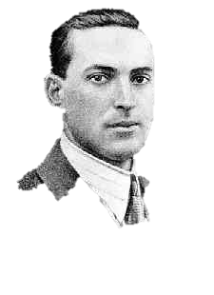


“the unique aspects of human cognition ... were driven by, or even constituted by, social co-operation”
(Moll & Tomasello 2007)
“perception, action, and cognition are grounded in social interaction”
(Sebanz & Knoblich 2008)

Slide 78
challenge
Explain the emergence, in evolution or development, of full-blown theory of mind cognition.
puzzle
What could infants, chimps and scrub-jays represent that would enable them, within limits, to track others’ perceptions, knowledge, beliefs and other propositional attitudes?
conjecture
The existence of abilities to engage in joint action partially explains how full-blown theory of mind cognition emerges in evolution or development (or both)

Slide 79
challenge
Explain the emergence, in evolution or development, of full-blown theory of mind cognition.
puzzle
What could infants, chimps and scrub-jays represent that would enable them, within limits, to track others’ perceptions, knowledge, beliefs and other propositional attitudes?
conjecture
The existence of abilities to engage in joint action partially explains how full-blown theory of mind cognition emerges in evolution or development (or both)

Slide 80
tidying up the toys together
(Behne et al 2005)
cooperatively pulling handles in sequence to make a dog-puppet sing
(Brownell et al 2006)
bouncing a ball on a large trampoline together
(Tomasello & Carpenter 2007)
pretending to row a boat together

Slide 81
Goal-directed joint action: an event with two or more agents which, taken as a whole, is directed to a goal.

Slide 82
Goal-directed joint action: an event with two or more agents which, taken as a whole, is directed to a goal.

Slide 83
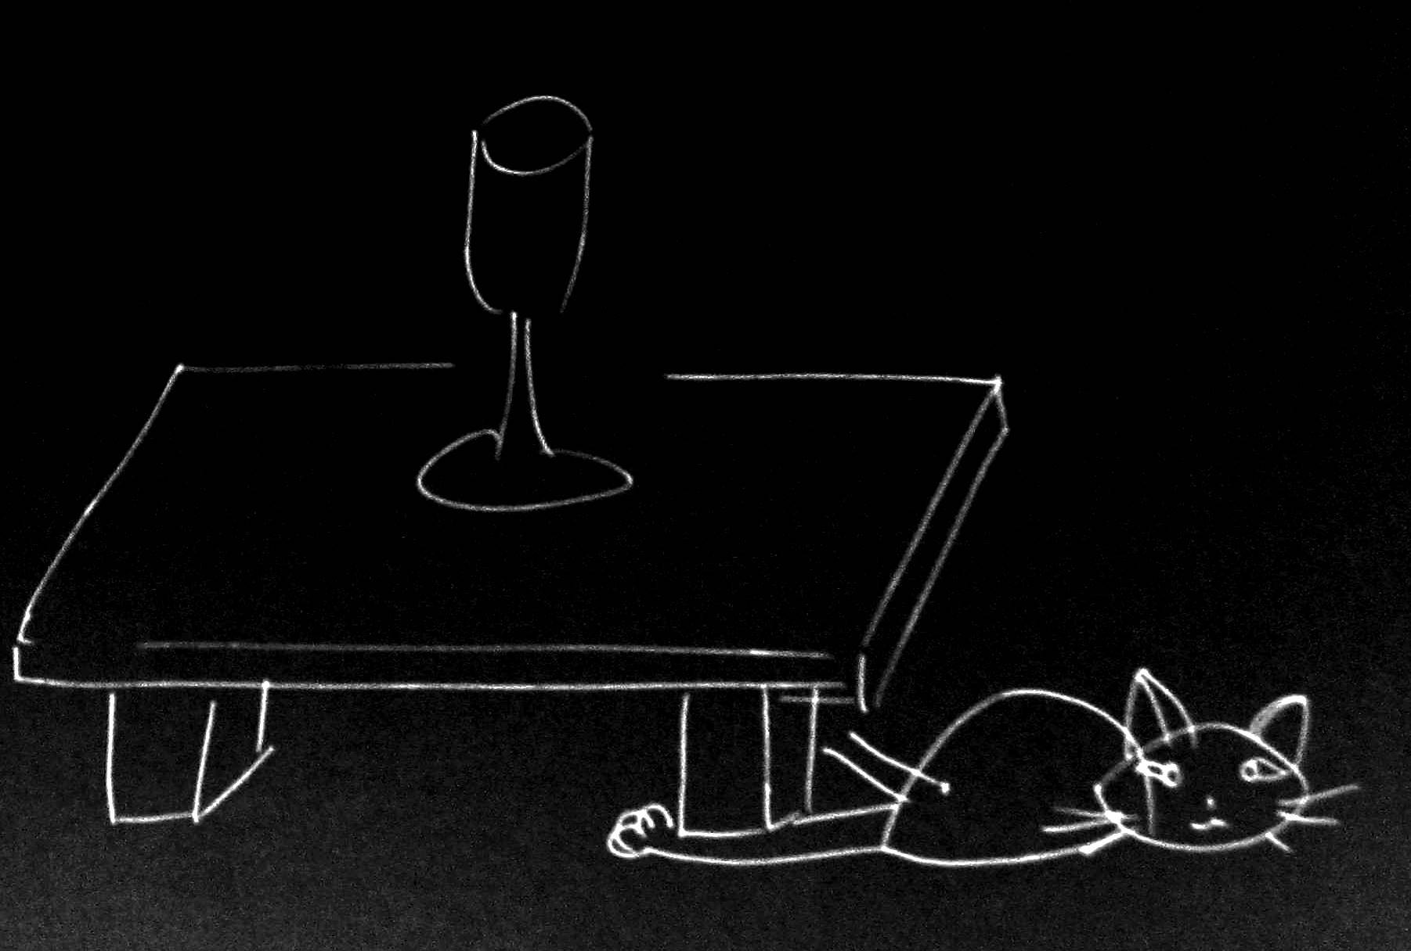
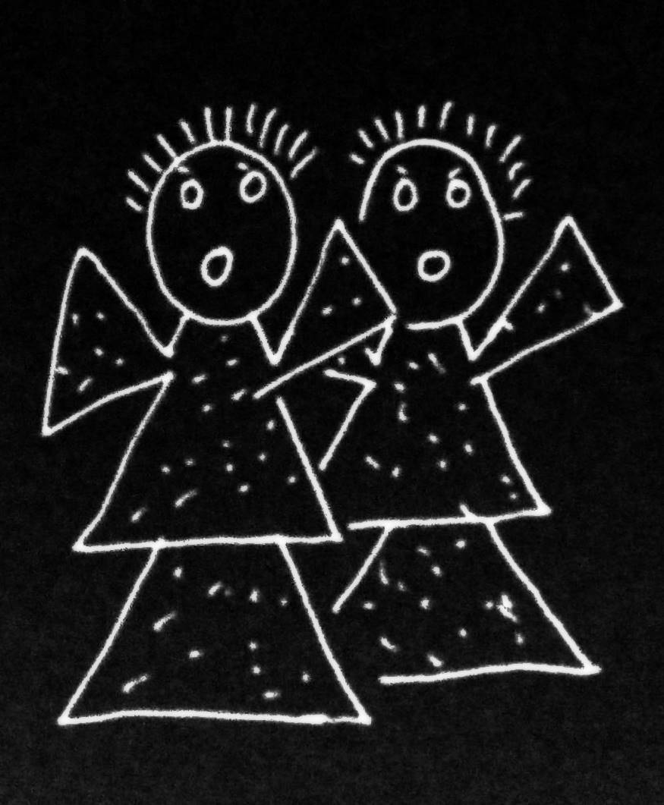
Goal-directed joint action: an event with two or more agents which, taken as a whole, is directed to a goal.

Slide 84
Goal-directed joint action: an event with two or more agents which, taken as a whole, is directed to a goal.

Slide 85
Goal-directed joint action: an event with two or more agents which, taken as a whole, is directed to a goal.
out
out
act
out
act
out

Slide 86
Goal-directed joint action: an event with two or more agents which, taken as a whole, is directed to a goal.
out
out
act
represents
coordinates
out
act
shared intention
out

Slide 87
Goal-directed joint action: an event with two or more agents which, taken as a whole, is directed to a goal.
???
out
out
act
represents
coordinates
out
act
shared intention
out

Slide 88
Goal-directed joint action: an event with two or more agents which, taken as a whole, is directed to a goal.
G is a distributive goal: it is an outcome to which each agent’s actions are individually directed and it is possible that: all actions succeed relative to this outcome.

Slide 89
Goal-directed joint action: an event with two or more agents which, taken as a whole, is directed to a goal.
G is a distributive goal: it is an outcome to which each agent’s actions are individually directed and it is possible that: all actions succeed relative to this outcome.
Nora’s shooting
Fred’s death
Olive’s shooting
Fred’s killing

Slide 90
Goal-directed joint action: an event with two or more agents which, taken as a whole, is directed to a goal.
G is a distributive goal: it is an outcome to which each agent’s actions are individually directed and it is possible that: all actions succeed relative to this outcome.
G is a collective goal
(a) it is a distributive goal;
(b) the actions are coordinated; and
(c) coordination of this type would normally facilitate occurrences of outcomes of this type.

Slide 91
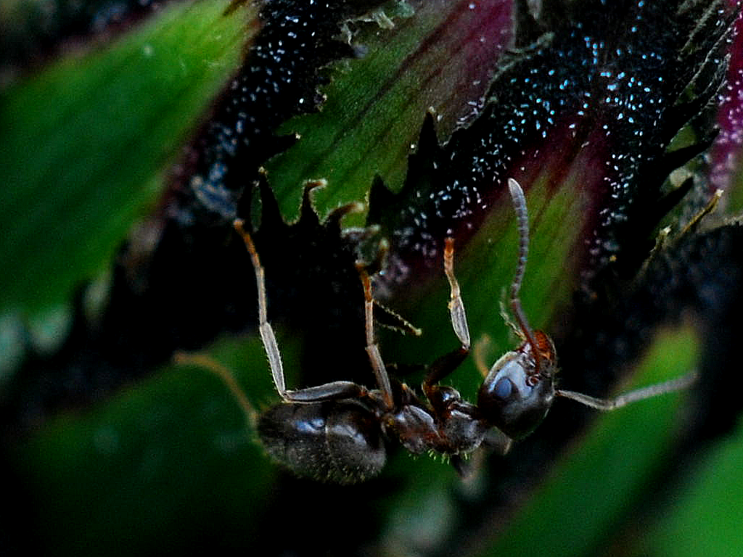

Slide 92
sting
sting
sting
sting
sting
death of fly
sting
sting
sting

Slide 93
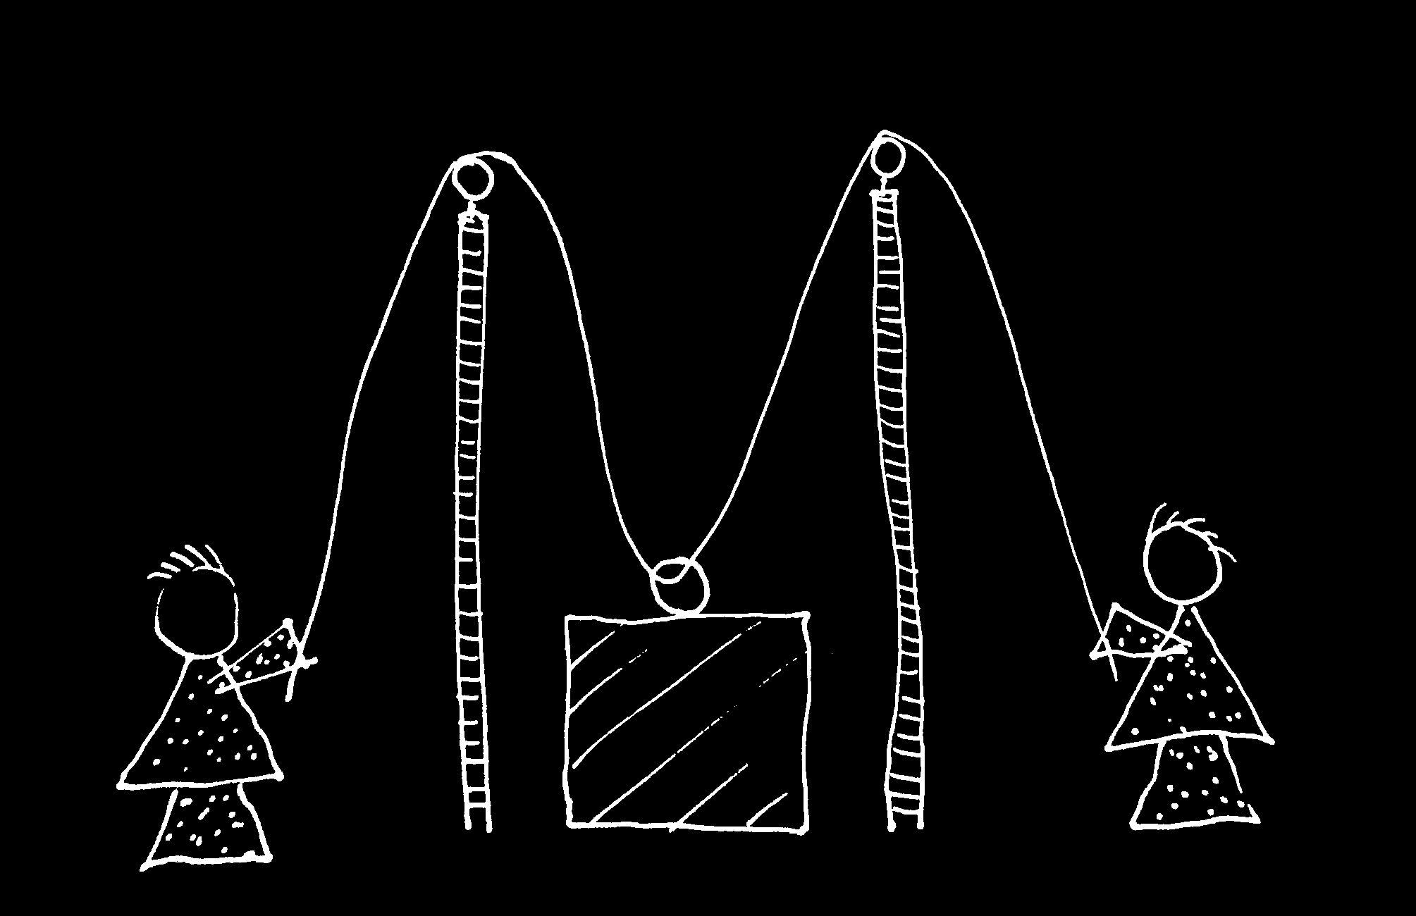

Slide 94
Goal-directed joint action: an event with two or more agents which, taken as a whole, is directed to a goal.
G is a distributive goal: it is an outcome to which each agent’s actions are individually directed and it is possible that: all actions succeed relative to this outcome.
G is a collective goal
(a) it is a distributive goal;
(b) the actions are coordinated; and
(c) coordination of this type would normally facilitate occurrences of outcomes of this type.

Slide 95
Goal-directed joint action: an event with two or more agents which, taken as a whole, is directed to a goal.
G is a distributive goal: it is an outcome to which each agent’s actions are individually directed and it is possible that: all actions succeed relative to this outcome.
G is a shared goal
G is a collective goal
(a) it is a distributive goal;
(b) the actions are coordinated; and
(c) coordination of this type would normally facilitate occurrences of outcomes of this type.
Each agent most wants and expects each of the other agents to perform activities directed to the goal.
Each agent most wants and expects the goal to occur as a common effect of all their goal-directed actions.

Slide 96
Goal-directed joint action: an event with two or more agents which, taken as a whole, is directed to a goal.
G is a distributive goal: it is an outcome to which each agent’s actions are individually directed and it is possible that: all actions succeed relative to this outcome.
G is a shared goal
G is a collective goal
(a) it is a distributive goal;
(b) the actions are coordinated; and
(c) coordination of this type would normally facilitate occurrences of outcomes of this type.
Each agent most wants and expects each of the other agents to perform activities directed to the goal.
Each agent most wants and expects the goal to occur as a common effect of all their goal-directed actions.

Slide 97
Goal-directed joint action: an event with two or more agents which, taken as a whole, is directed to a goal.
G is a distributive goal: it is an outcome to which each agent’s actions are individually directed and it is possible that: all actions succeed relative to this outcome.
G is a shared goal
G is a collective goal
(a) it is a distributive goal;
(b) the actions are coordinated; and
(c) coordination of this type would normally facilitate occurrences of outcomes of this type.
Each agent most wants and expects each of the other agents to perform activities directed to the goal.
Each agent most wants and expects the goal to occur as a common effect of all their goal-directed actions.

Slide 98
Goal-directed joint action: an event with two or more agents which, taken as a whole, is directed to a goal.
G is a distributive goal: it is an outcome to which each agent’s actions are individually directed and it is possible that: all actions succeed relative to this outcome.
G is a shared goal
G is a collective goal
(a) it is a distributive goal;
(b) the actions are coordinated; and
(c) coordination of this type would normally facilitate occurrences of outcomes of this type.
Each agent most wants and expects each of the other agents to perform activities directed to the goal.
Each agent most wants and expects the goal to occur as a common effect of all their goal-directed actions.

Slide 99
Goal-directed joint action: an event with two or more agents which, taken as a whole, is directed to a goal.
etc ...
G is a distributive goal: it is an outcome to which each agent’s actions are individually directed and it is possible that: all actions succeed relative to this outcome.
G is a shared goal
G is a collective goal
(a) it is a distributive goal;
(b) the actions are coordinated; and
(c) coordination of this type would normally facilitate occurrences of outcomes of this type.
Each agent most wants and expects each of the other agents to perform activities directed to the goal.
Each agent most wants and expects the goal to occur as a common effect of all their goal-directed actions.

Slide 100
challenge
Explain the emergence, in evolution or development, of full-blown theory of mind cognition.
puzzle
What could infants, chimps and scrub-jays represent that would enable them, within limits, to track others’ perceptions, knowledge, beliefs and other propositional attitudes?
conjecture
The existence of abilities to engage in joint action partially explains how full-blown theory of mind cognition emerges in evolution or development (or both)

Slide 101
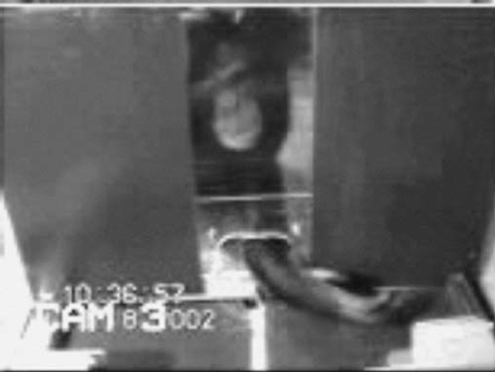
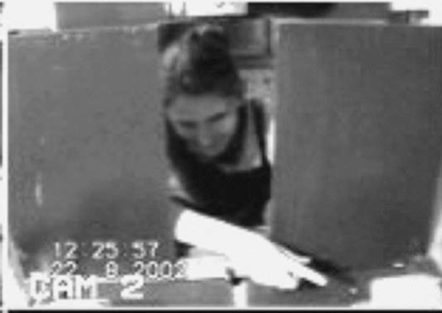
failed reach
point
source: Hare & Tomasello (2004)
Notes:
this illustrates problem of identifying particular goals of action

Slide 102
The problem of opaque means

Slide 103
your-goal-is-my-goal

Slide 104
your-goal-is-my-goal
1. We are about to engage in some joint action* or other
2. I am not about to change my goal.
Therefore:
3. Your actions also will be directed to this goal.
[*in at least the minimal sense associated with distributive goals]

Slide 105
failed reach
point
source: Hare & Tomasello (2004)

Slide 106
failed reach
point
source: Hare & Tomasello (2004)
“to understand pointing, the subject needs to understand more than the individual goal-directed behaviour. She needs to understand that ... the other attempts to communicate to her ... and ... the communicative intention behind the gesture”
(Moll & Tomsello 2007)

Slide 107
failed reach
point
source: Hare & Tomasello (2004)
“to understand pointing, the subject needs to understand more than the individual goal-directed behaviour. She needs to understand that ... the other attempts to communicate to her ... and ... the communicative intention behind the gesture”
(Moll & Tomsello 2007)

Slide 108
challenge
Explain the emergence, in evolution or development, of full-blown theory of mind cognition.
puzzle
What could infants, chimps and scrub-jays represent that would enable them, within limits, to track others’ perceptions, knowledge, beliefs and other propositional attitudes?
conjecture
The existence of abilities to engage in joint action partially explains how full-blown theory of mind cognition emerges in evolution or development (or both)

Slide 109

minimal theory of mind cognition
joint action (ability to share goals)
(mis)understanding communicative intent
other stuff
communication by language
other stuff
sophisticated theory of mind cognition

